Slide 1
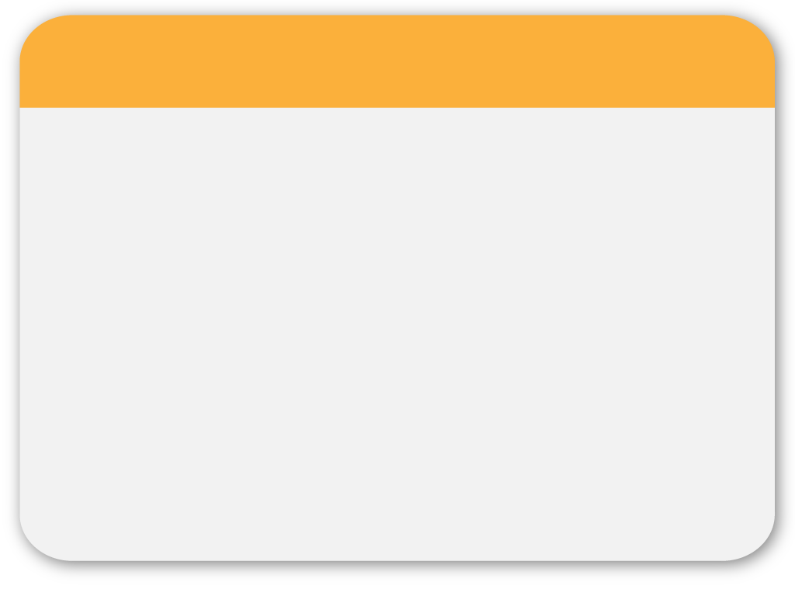
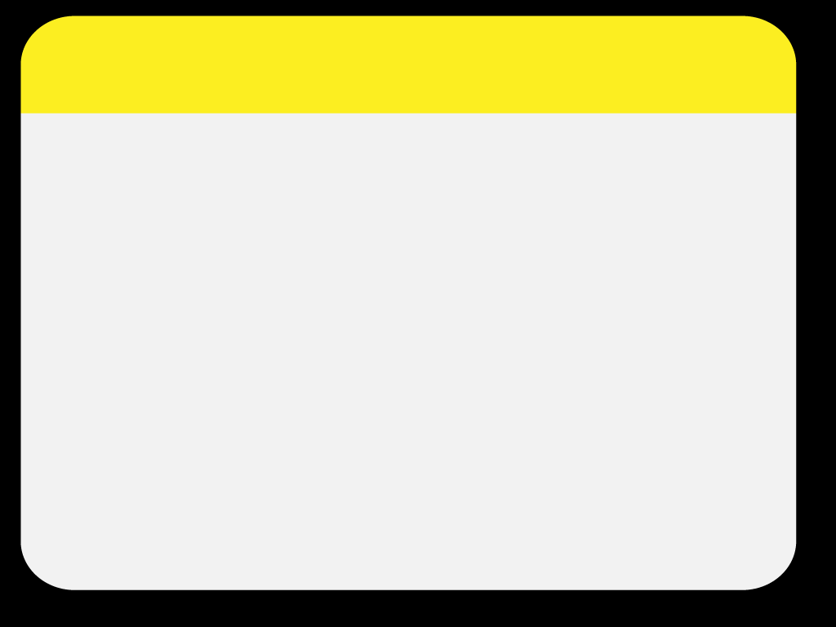
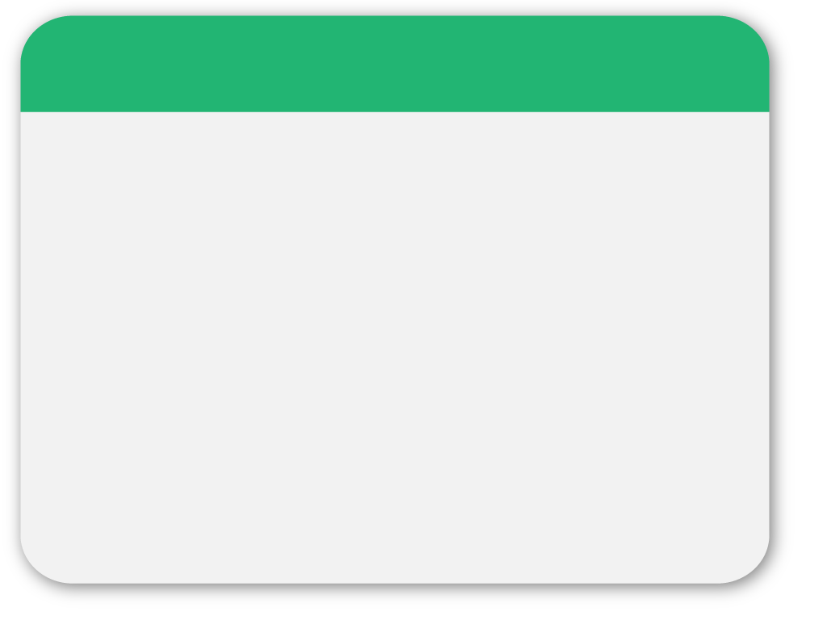
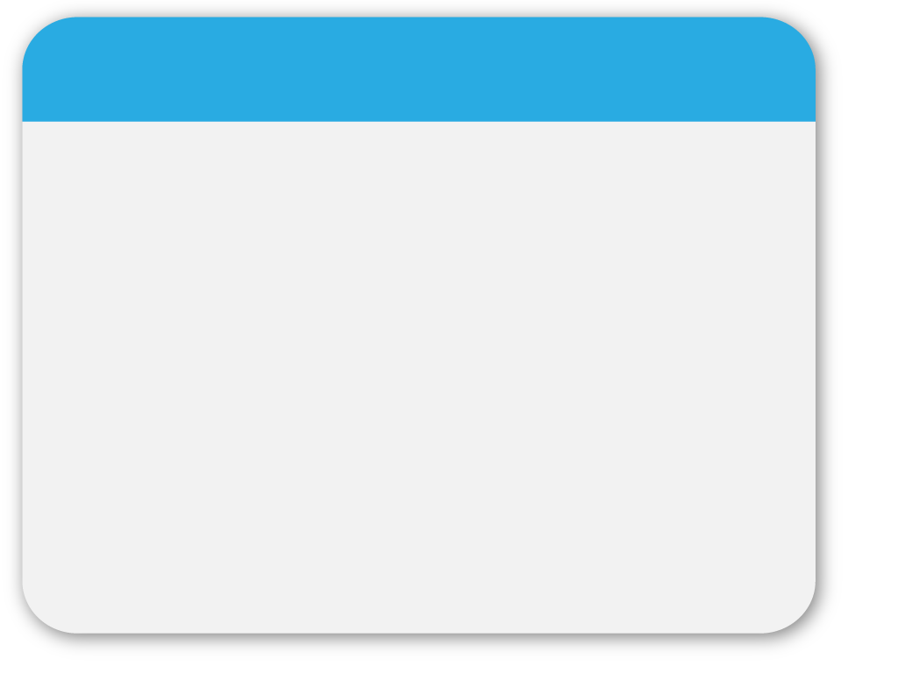
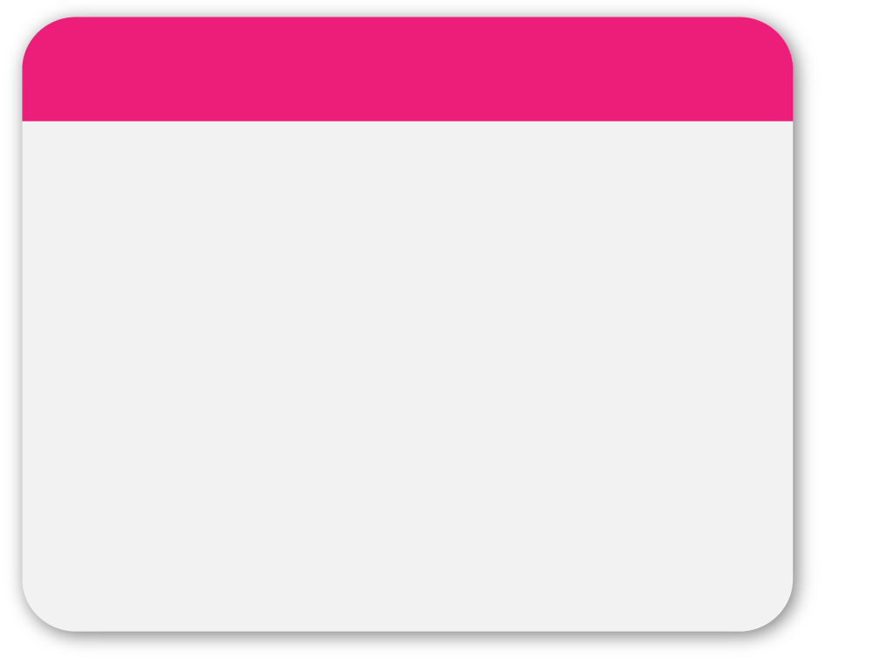
NMLab
WINTER
Template
FINAL PROJECT
電機四 B97901031 向思蓉
B97901116 王鼎鈞
B97901118 蘇仲岐

Slide 2
Outline
WINTER
Infrastructure
Android
OpenCV)
AR & OpenGL伴奏)
Q&A線伴奏)

Slide 3
Infrastructure
WINTER
Hardware
Augmented reality
Open camera
Qualcomm token recognition
OpenGL
detect
Image Process
Color Filter
OpenCV
Android
VIEWS
GUI Views
GLSurfaceView
UI handler

Slide 4
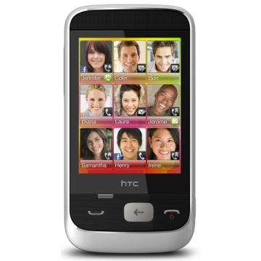
Android
TCP socket (P2P)
server
Team Yellow
Team Blue

Slide 5
Android
Views OverLay
Special Effect
Android UI
Qualcomm AR

Slide 6
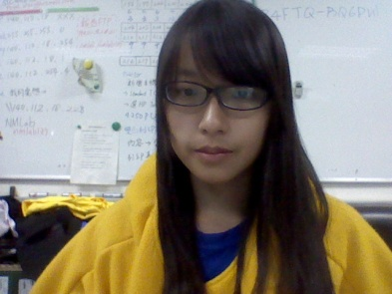
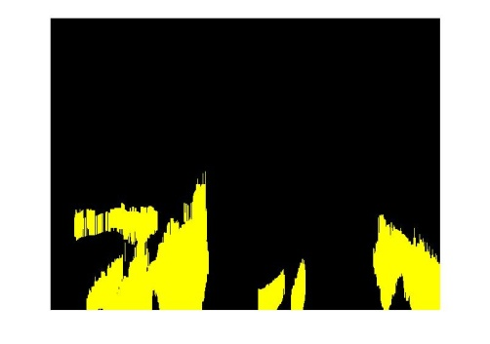
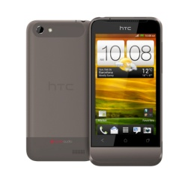
OPENCV
COLOR EXTRACTION
GetPixel
Color Filter
Contour & Cendroid
Dilate

Slide 7
AR & OpenGL & OpenCV
Camera for AR: C++ code
Camera for OpenCV: call OpenCV library
AR
Qualcomm library
OpenGL
Can not use the same camera
?
Gl View print screen
OpenCV

Slide 8
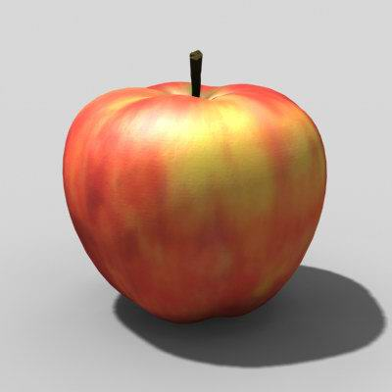
OpenGL & AR
Use Qualcomm AR & OpenGL
Token Recognition
3D Model
Load
Token
Vertex
Normal
Texture Coordinate
Texture Map
OpenGL
Android View

Slide 9
Live Demo

Slide 10
Q&A
THANKS!

